Slide 1
Lecture
Recurrence Relations and how to solve them!

Slide 2
Last time….
Sorting: InsertionSort and MergeSort
What does it mean to work and be fast?
Worst-Case Analysis
Big-Oh Notation
Analyzing running time of recursive algorithms
By writing out a tree and adding up all the work done.

Slide 3
Today
Recurrence Relations!
How do we calculate the runtime a recursive algorithm?
The Master Method
A useful theorem so we don’t have to answer this question from scratch each time.
The Substitution Method
A different way to solve recurrence relations, more general than the Master Method.

Slide 4
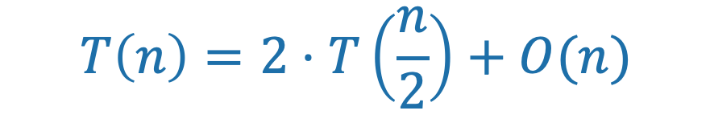
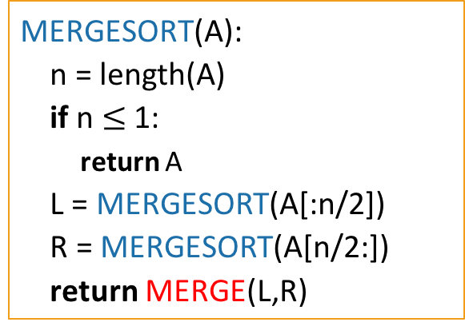
Running time of MergeSort
Let T(n) be the running time of MergeSort on a length n array.
We know that T(n) = O(nlog(n)).
We also know that T(n) satisfies:
MERGESORT(A):
n = length(A)
if n $≤$ 1:
return A
L = MERGESORT(A[:n/2])
R = MERGESORT(A[n/2:])
return MERGE(L,R)
$$T\left(n\right)=2⋅T\left(\frac{n}{2}\right)+O(n)$$

Slide 5
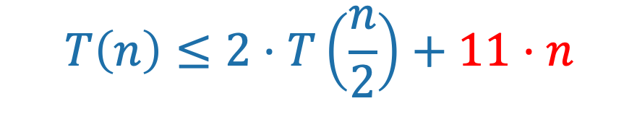
Running time of MergeSort
Let T(n) be the running time of MergeSort on a length n array.
We know that T(n) = O(nlog(n)).
We also know that T(n) satisfies:
MERGESORT(A):
n = length(A)
if n $≤$ 1:
return A
L = MERGESORT(A[:n/2])
R = MERGESORT(A[n/2:])
return MERGE(L,R)
$$T\left(n\right)≤2⋅T\left(\frac{n}{2}\right)+11⋅n$$
Last time we showed that the time to run MERGE on a problem of size n is O(n). For concreteness, let’s say that it’s at most 11n operations.

Slide 6
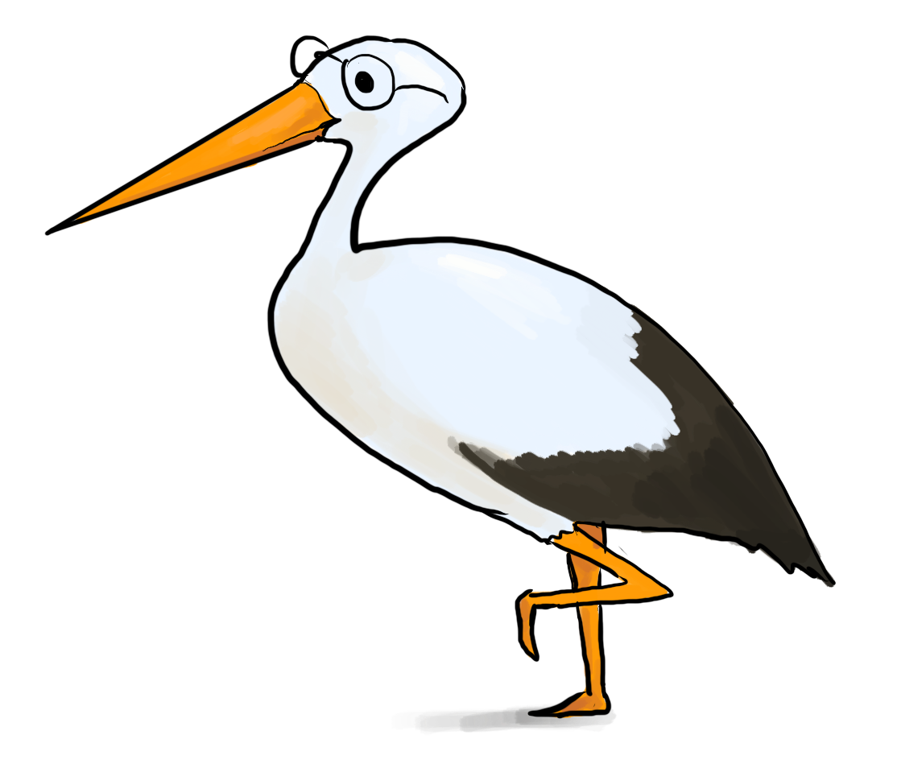
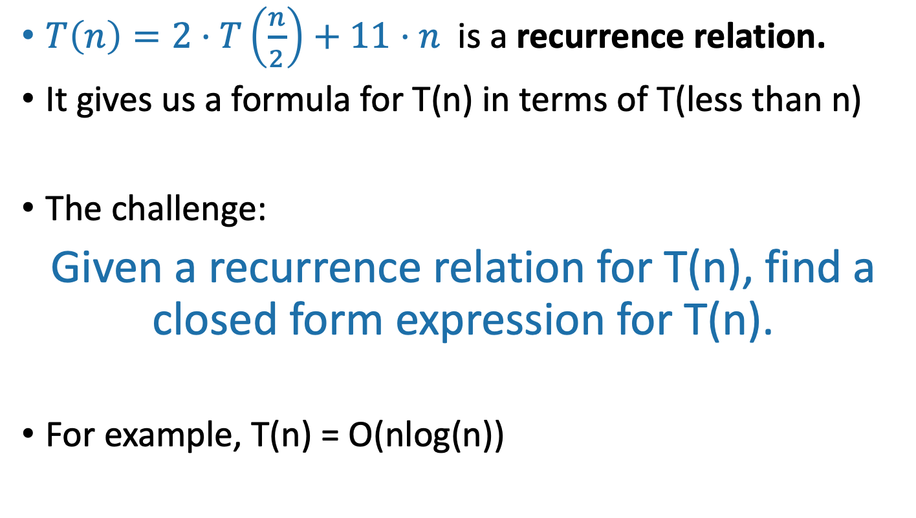
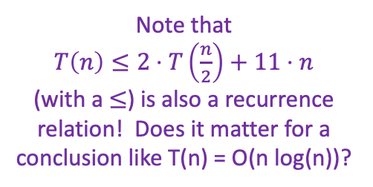
Recurrence Relations
$T\left(n\right)=2⋅T\left(\frac{n}{2}\right)+11⋅n$ is a recurrence relation.
It gives us a formula for T(n) in terms of T(less than n)
The challenge:
Given a recurrence relation for T(n), find a closed form expression for T(n).
For example, T(n) = O(nlog(n))
Note that
$T\left(n\right)≤2⋅T\left(\frac{n}{2}\right)+11⋅n$
(with a $≤$) is also a recurrence relation! Does it matter for a conclusion like T(n) = O(n log(n))?

Slide 7
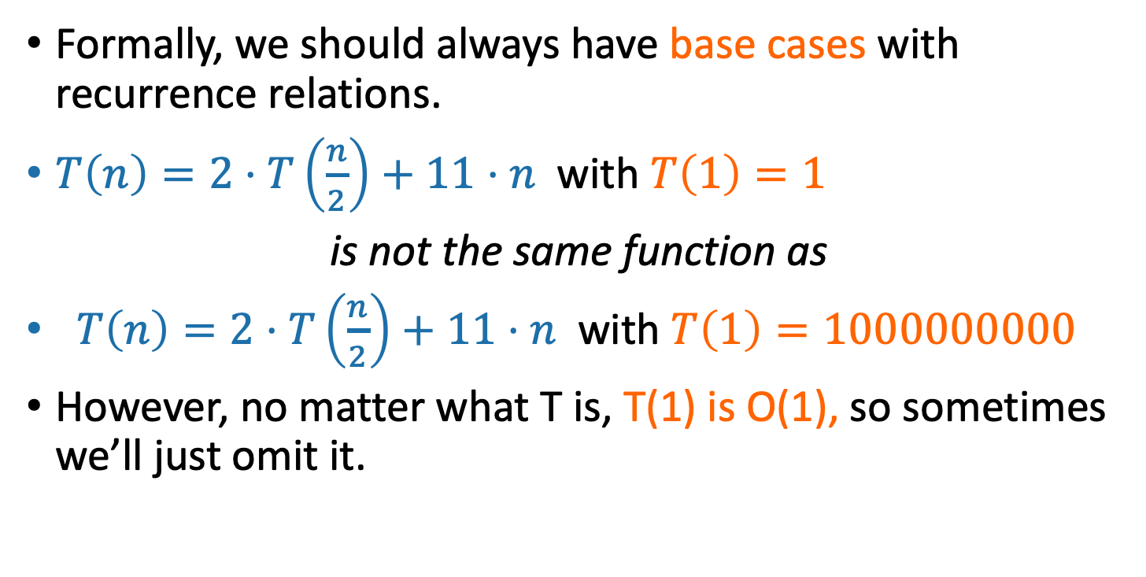
Technicalities I Base Cases
Formally, we should always have base cases with recurrence relations.
$T\left(n\right)=2⋅T\left(\frac{n}{2}\right)+11⋅n$with $T\left(1\right)=1$
is not the same function as
$T\left(n\right)=2⋅T\left(\frac{n}{2}\right)+11⋅n$with $T\left(1\right)=1000000000$
However, no matter what T is, T(1) is O(1), so sometimes we’ll just omit it.
Why is T(1) = O(1)?

Slide 8
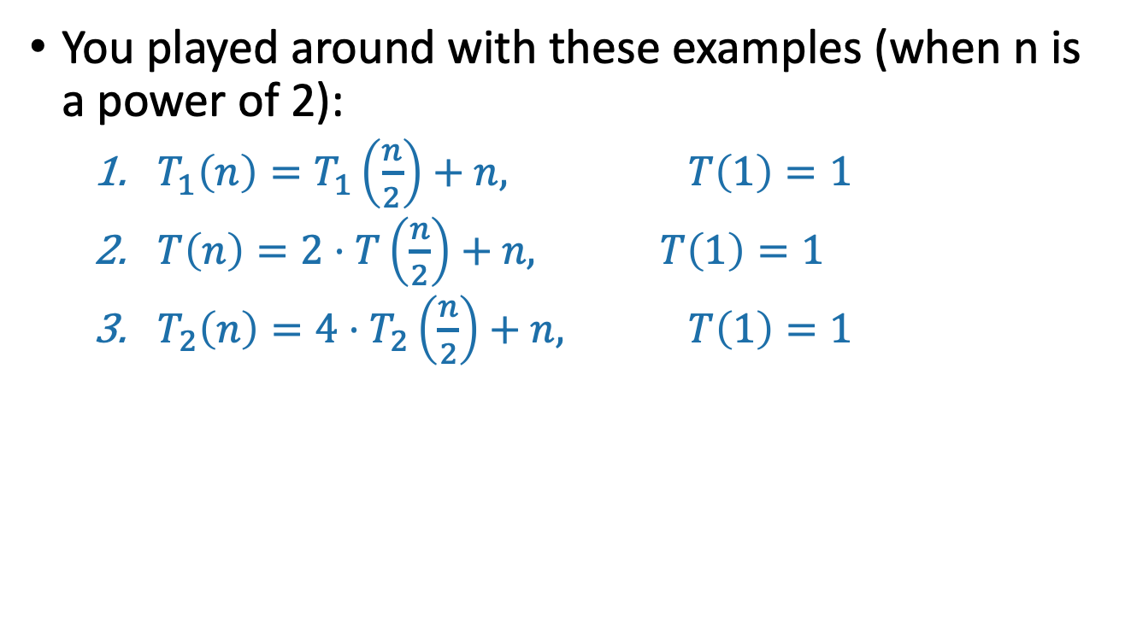
You played around with these examples (when n is a power of 2):
$T_{1}\left(n\right)=T_{1}\left(\frac{n}{2}\right)+n, T\left(1\right)=1$
$T\left(n\right)=2⋅T\left(\frac{n}{2}\right)+n, T\left(1\right)=1$
$T_{2}\left(n\right)=4⋅T_{2}\left(\frac{n}{2}\right)+n, T\left(1\right)=1$

Slide 9
One approach for all of these
Size n
The “tree” approach from last time.
Add up all the work done at all the sub-problems.
n/2
n/2
n/4
n/4
n/4
n/4
…
n/2^{t}
n/2^{t}
n/2^{t}
n/2^{t}
n/2^{t}
n/2^{t}
…
(Size 1)

Slide 10
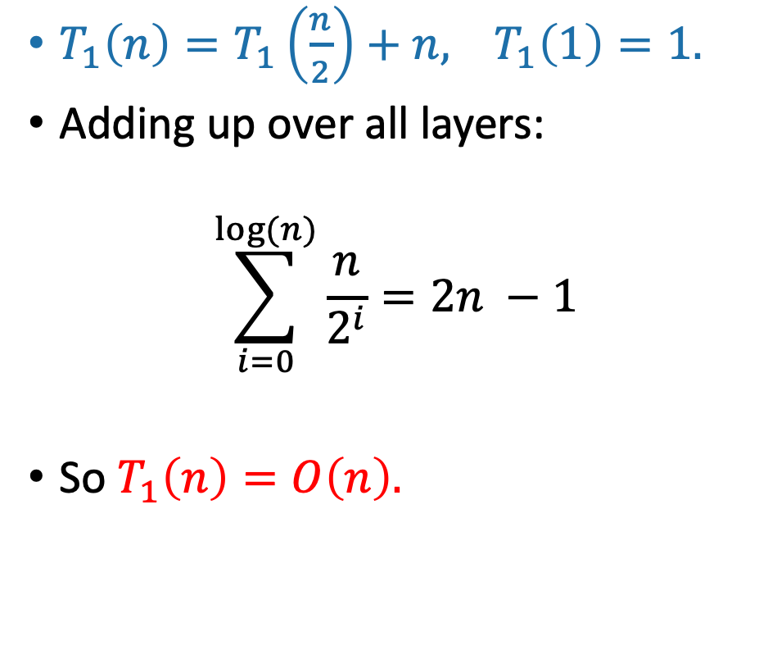
Contribution at this layer:
$T_{1}\left(n\right)=T_{1}\left(\frac{n}{2}\right)+n,$ $T_{1}\left(1\right)=1.$
Adding up over all layers:
$$\sum_{i=0}^{log⁡(n)}{\frac{n}{2^{i}}=2n −1}$$
So $T_{1}\left(n\right)=O\left(n\right).$
Size n
n
n/2
n/2
n/4
n/4
…
n/2^{t}
n/2^{t}
…
1
(Size 1)

Slide 11
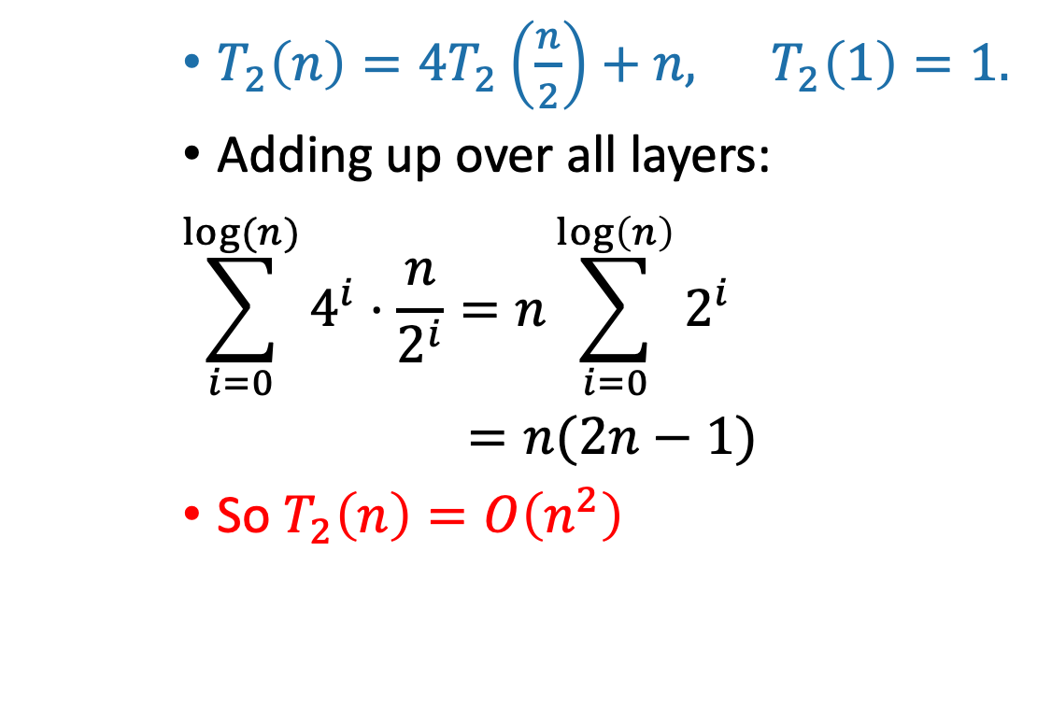
$T_{2}\left(n\right)={4T}_{2}\left(\frac{n}{2}\right)+n,$ $T_{2}\left(1\right)=1.$
Adding up over all layers:
$$\sum_{i=0}^{log⁡(n)}{4^{i}⋅\frac{n}{2^{i}}=n\sum_{i=0}^{\log\left(n\right)}{2^{i}}}$$
$=n(2n−1)$
So $T_{2}\left(n\right)=O\left(n^{2}\right)$
Contribution at this layer:
Size n
n
4x
n/2
2n
16x
n/4
4n
…
4^{t} x
n/2^{t}
2^{t}n
…
n² x
n²
(Size 1)

Slide 12
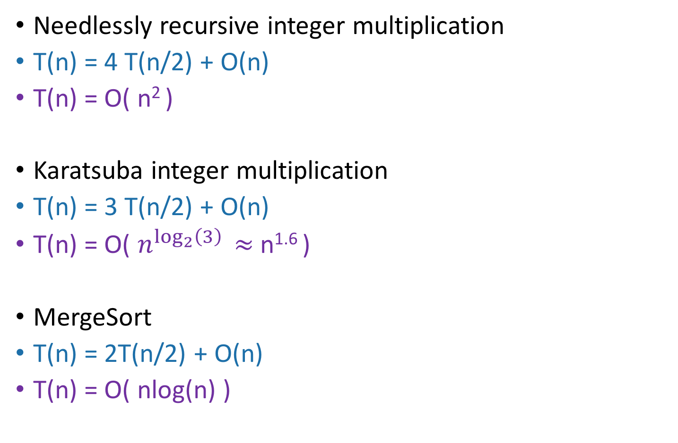
More examples
T(n) = time to solve a problem of size n.
Needlessly recursive integer multiplication
T(n) = 4 T(n/2) + O(n)
T(n) = O( n² )
Karatsuba integer multiplication
T(n) = 3 T(n/2) + O(n)
T(n) = O( $n^{\log_{2}\left(3\right)}$ $≈$ n^{1.6} )
MergeSort
T(n) = 2T(n/2) + O(n)
T(n) = O( nlog(n) )
What’s the pattern?!?!?!?!

Slide 13
The master theorem
A useful
formula it is.
Know why it works you should.
A formula for many recurrence relations.
You’ll come up with an example in next class when it won’t work.
Proof: “Generalized” tree method.
Jedi master Yoda

Slide 14
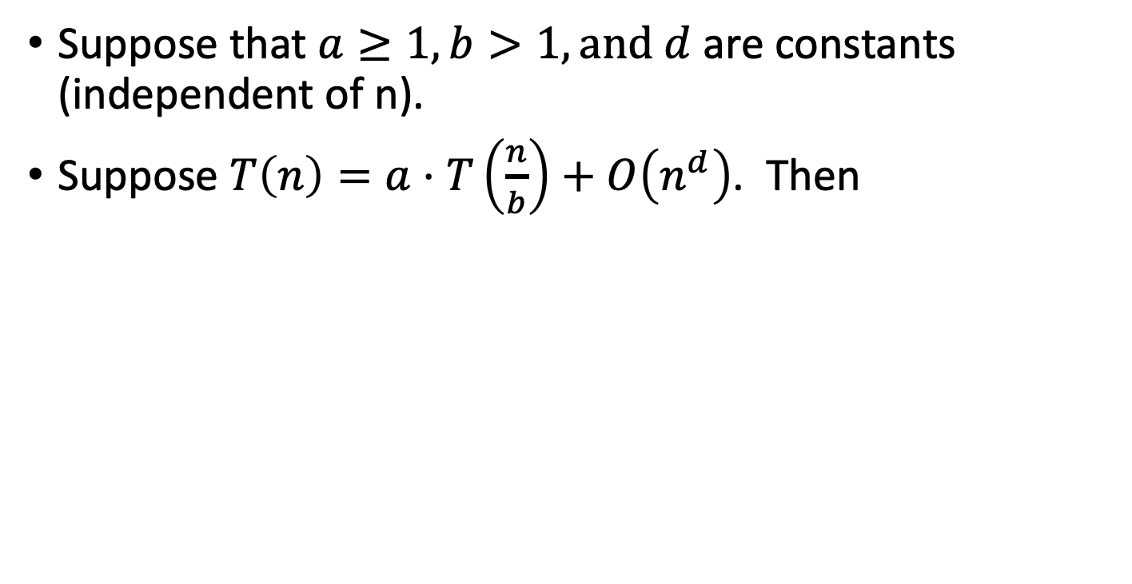
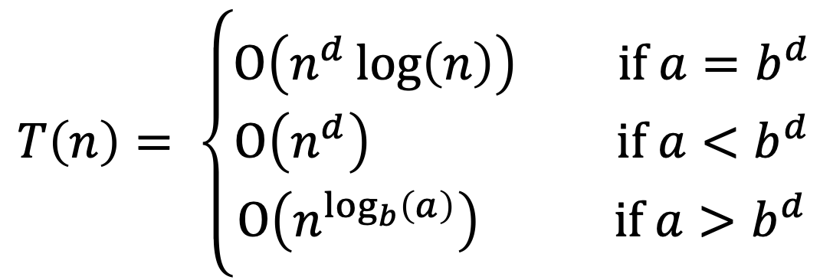
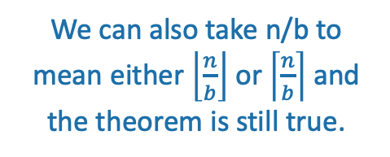
The master theorem
We can also take n/b to mean either $\left\lfloor \frac{n}{b}\right\rfloor$ or $\left\lceil \frac{n}{b}\right\rceil$ and the theorem is still true.
Suppose that $a≥1,b>1,and d$ are constants (independent of n).
Suppose $T\left(n\right)=a⋅T\left(\frac{n}{b}\right)+O\left(n^{d}\right)$. Then
$$T\left(n\right)= \left\{\begin{aligned}O\left(n^{d}\log\left(n\right)\right) if a=b^{d} \\ O\left(n^{d}\right) if a<b^{d} \\ O\left(n^{\log_{b}\left(a\right)}\right) if a>b^{d}\end{aligned}\right.$$
Three parameters:
a : number of subproblems
b : factor by which input size shrinks
d : need to do n^{d} work to create all the subproblems and combine their solutions.
Many symbols those are….

Slide 15
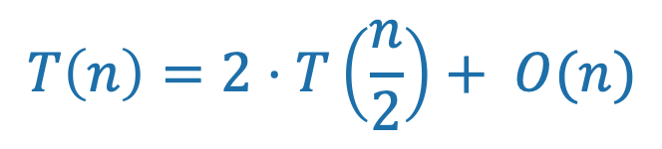
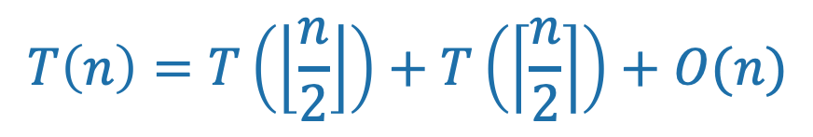
Technicalities II Integer division
If n is odd, I can’t break it up into two problems of size n/2.
However one can show that the Master theorem works fine if you pretend that what you have is:
From now on we’ll mostly ignore floors and ceilings in recurrence relations.
$$T\left(n\right)=T\left(\left\lfloor \frac{n}{2}\right\rfloor \right)+T\left(\left\lceil \frac{n}{2}\right\rceil \right)+O(n)$$
$$T\left(n\right)=2⋅T\left(\frac{n}{2}\right)+ O(n)$$

Slide 16
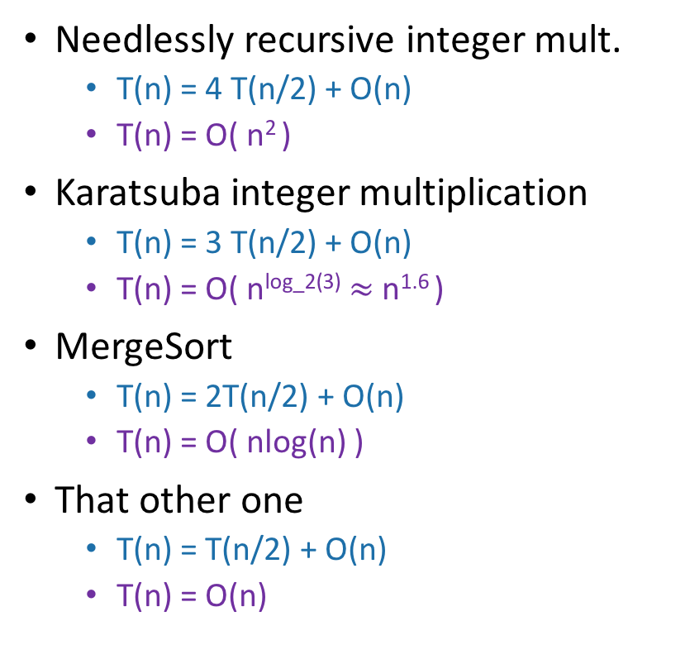
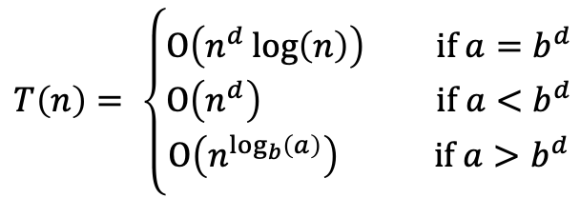
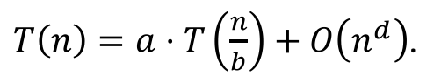
Examples (details on board)
$T\left(n\right)=a⋅T\left(\frac{n}{b}\right)+O\left(n^{d}\right)$.
$$T\left(n\right)= \left\{\begin{aligned}O\left(n^{d}\log\left(n\right)\right) if a=b^{d} \\ O\left(n^{d}\right) if a<b^{d} \\ O\left(n^{\log_{b}\left(a\right)}\right) if a>b^{d}\end{aligned}\right.$$
Needlessly recursive integer mult.
T(n) = 4 T(n/2) + O(n)
T(n) = O( n² )
Karatsuba integer multiplication
T(n) = 3 T(n/2) + O(n)
T(n) = O( n^{log_2(3)} $≈$ n^{1.6} )
MergeSort
T(n) = 2T(n/2) + O(n)
T(n) = O( nlog(n) )
That other one
T(n) = T(n/2) + O(n)
T(n) = O(n)
✓
a = 4
b = 2
d = 1
a > b^{d}
✓
a = 3
b = 2
d = 1
a > b^{d}
✓
a = 2
b = 2
d = 1
a = b^{d}
✓
a = 1
b = 2
d = 1
a < b^{d}

Slide 17
Even more generally, for T(n) = aT(n/b) + f(n)…
[From CLRS – you won’t need to know this fancier version for this class unless you want to.]
Figure out how to adapt the proof we gave to prove this more general version!

Slide 18
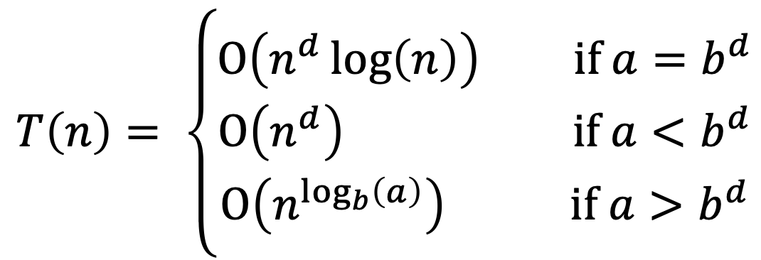
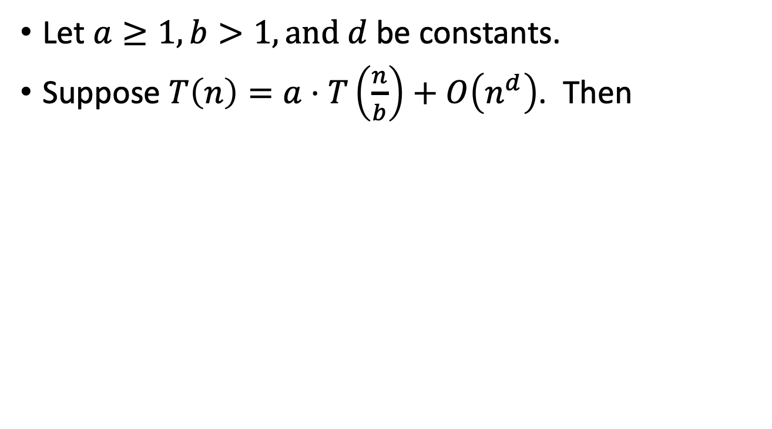
Understanding the Master Theorem
Let $a≥1,b>1,and d$ be constants.
Suppose $T\left(n\right)=a⋅T\left(\frac{n}{b}\right)+O\left(n^{d}\right)$. Then
$$T\left(n\right)= \left\{\begin{aligned}O\left(n^{d}\log\left(n\right)\right) if a=b^{d} \\ O\left(n^{d}\right) if a<b^{d} \\ O\left(n^{\log_{b}\left(a\right)}\right) if a>b^{d}\end{aligned}\right.$$
What do these three cases mean?

Slide 19
The eternal struggle
Branching causes the number of problems to explode!
The most work is at the bottom of the tree!
The problems lower in the tree are smaller! The most work is at the top of the tree!

Slide 20
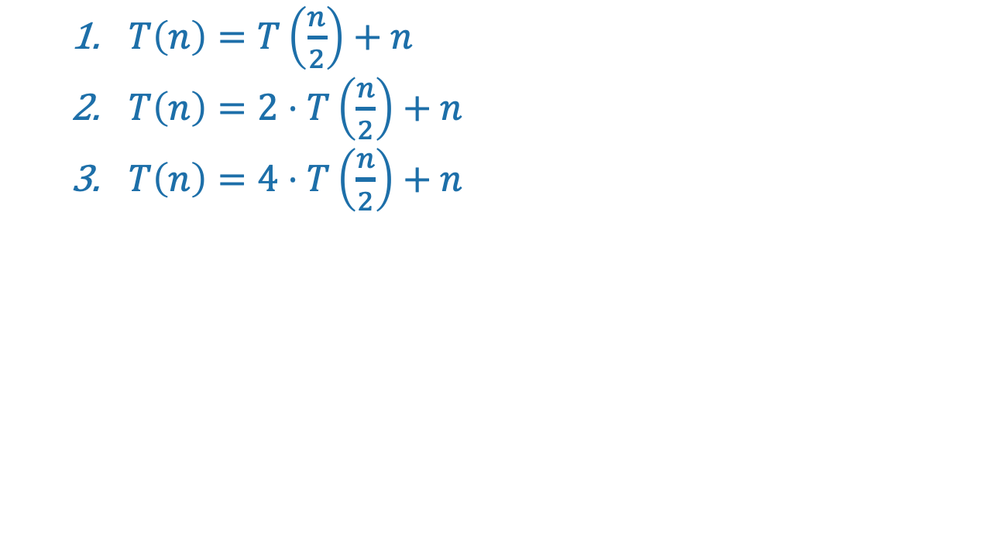
Consider our three warm-ups
$T\left(n\right)=T\left(\frac{n}{2}\right)+n$
$T\left(n\right)=2⋅T\left(\frac{n}{2}\right)+n$
$T\left(n\right)=4⋅T\left(\frac{n}{2}\right)+n$

Slide 21
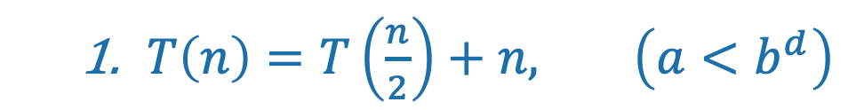
First example: tall and skinny tree
$T\left(n\right)=T\left(\frac{n}{2}\right)+n, \left(a<b^{d}\right)$
Size n
The amount of work done at the top (the biggest problem) swamps the amount of work done anywhere else.
T(n) = O( work at top ) = O(n)
n/2
n/4
n/2^{t}
WINNER
Most work at the top of the tree!
1

Slide 22
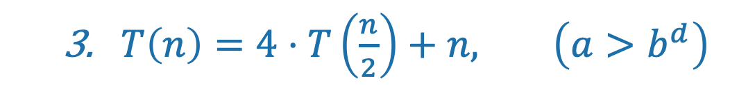
Third example: bushy tree
WINNER
$T\left(n\right)=4⋅T\left(\frac{n}{2}\right)+n, \left(a>b^{d}\right)$
Size n
Most work at the bottom of the tree!
n/2
n/2
n/2
n/2
There are a HUGE number of leaves, and the total work is dominated by the time to do work at these leaves.
T(n) = O( work at bottom ) = O( 4^{depth of tree} ) = O(n²)
1
1
1
1
1
1
1
1
1
1
1
1
1
1
1
1
1
1
1
1
1
1
1
1
1
1
1
1
1
1
1
1
1
1
1
1
1
1
1
1
1
1
1
1
1
1
1
1
1
1
1
1
1
1
1
1
1
1
1
1
1
1
1

Slide 23
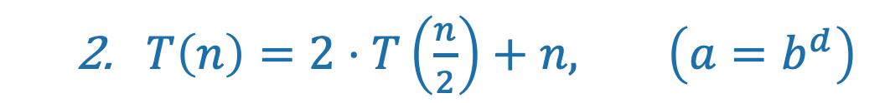
Second example: just right
$T\left(n\right)=2⋅T\left(\frac{n}{2}\right)+n, \left(a=b^{d}\right)$
Size n
The branching just balances out the amount of work.
n/2
n/2
The same amount of work is done at every level.
n/4
n/4
n/4
n/4
T(n) = (number of levels) * (work per level)
= log(n) * O(n) = O(nlog(n))
TIE!
1
1
1
1
1
1
1
1
1
1

Slide 24
What have we learned?
The “Master Method” makes our lives easier.
But it’s basically just codifying a calculation we could do from scratch if we wanted to.

Slide 25
The Substitution Method
Another way to solve recurrence relations.
More general than the master method.

Slide 26
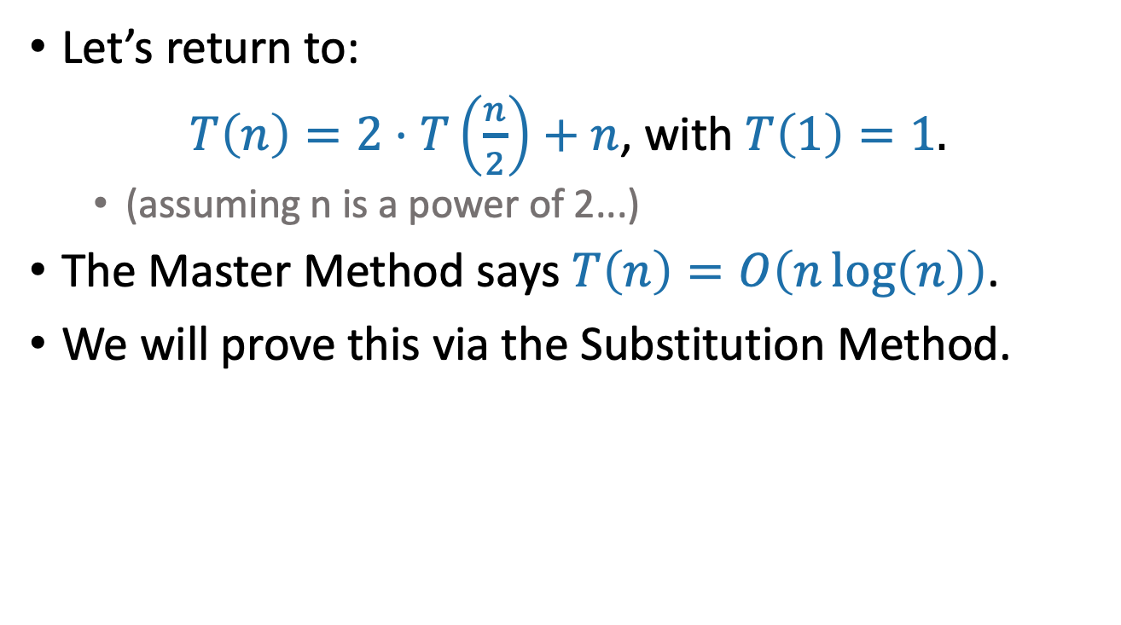
The Substitution Method first example
Let’s return to:
$T\left(n\right)=2⋅T\left(\frac{n}{2}\right)+n$, with $T\left(1\right)=1.$
(assuming n is a power of 2...)
The Master Method says $T\left(n\right)=O\left(n\log\left(n\right)\right)$.
We will prove this via the Substitution Method.

Slide 27

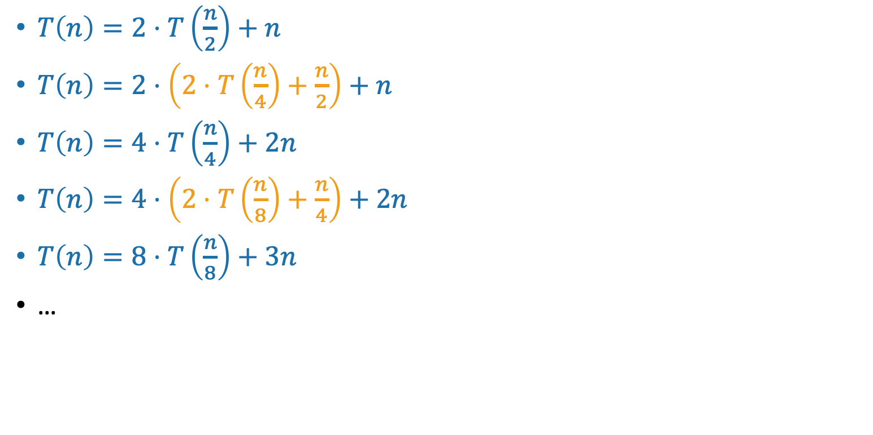
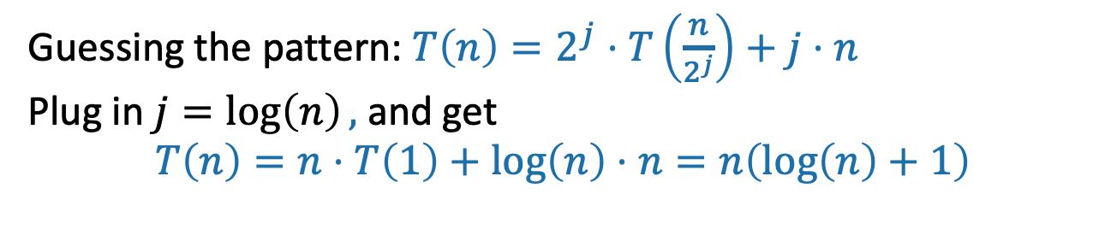
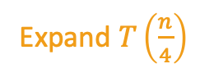
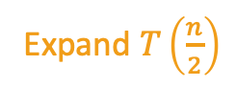
Step 1: Guess the answer
$T\left(n\right)=2⋅T\left(\frac{n}{2}\right)+n$, with $T\left(1\right)=1.$
You can guess the answer however you want: meta-reasoning, a little bird told you, wishful thinking, etc. One useful way is to try to “unroll” the recursion, like we’re doing here.
$T\left(n\right)=2⋅T\left(\frac{n}{2}\right)+n$
$T\left(n\right)=2⋅\left(2⋅T\left(\frac{n}{4}\right)+\frac{n}{2}\right)+n$
$T\left(n\right)=4⋅T\left(\frac{n}{4}\right)+2n$
$T\left(n\right)=4⋅\left(2⋅T\left(\frac{n}{8}\right)+\frac{n}{4}\right)+2n$
$T\left(n\right)=8⋅T\left(\frac{n}{8}\right)+3n$
…
Expand $T\left(\frac{n}{2}\right)$
Simplify
Expand $T\left(\frac{n}{4}\right)$
Simplify
Guessing the pattern: $T\left(n\right)=2^{j}⋅T\left(\frac{n}{2^{j}}\right)+j⋅n$
Plug in $j=\log\left(n\right),$ and get
$$T\left(n\right)=n⋅T\left(1\right)+\log\left(n\right)⋅n=n\left(\log\left(n\right)+1\right)$$

Slide 28
Why two methods?
Sometimes the Substitution Method works where the Master Method does not.

Slide 29
Next Time
What happens if the sub-problems are different sizes?
And when might that happen?

